Slide 1
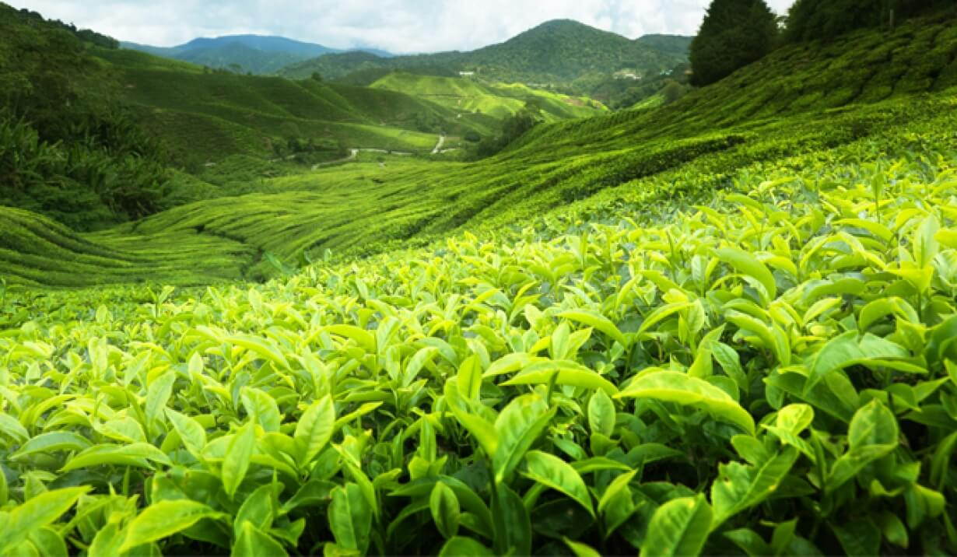
Ceylon tea and Its impact of the economy
Sri Lanka's Gift to the World

Slide 2

Introduction to Ceylon tea
Geographical Influence:
Grown in Sri Lanka, formerly called Ceylon, at various altitudes, each contributing differently to give flavor to the teas.
From the cool highlands down to the warmer lowlands, each of these climates differs in the effect it has upon the taste and quality of the tea.
Global Recognition:
It is one of the most famous teas in the world for its rich flavor, bright color, and refreshing taste.
The Lion Logo identifies this as a seal of authenticity and quality from Sri Lanka Tea Board.
Considered to be amongst the finest in the world, Ceylon Tea is known for its purity and full-bodied taste.
Types of Ceylon Tea:
Black Tea: The most popular, with a strong and aromatic flavor.
Green Tea: Milder, with a fresh and grassy taste, is gaining popularity for its health benefits.
White Tea: Delicate, rare, and more expensive, with a subtle flavor and less processing.

Slide 3
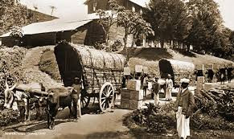
History of the Ceylon tea
Early Beginnings:
Located in the early 19th century, Sri Lanka was known as Ceylon and ranked among major producers of coffee.
1824: The British introduced the first tea plant Camellia sinensis to Ceylon, principally for botanical purposes rather than cultivation.
The Coffee Blight:
1860s: A fungal disease called coffee rust (Hemileia vastatrix) devastated coffee plantations across Ceylon.
As coffee crops were ruined, planters sought alternative crops to cultivate.
Introduction of Tea by James Taylor:
1867: James Taylor, a Scottish planter, planted the first seedlings of tea on Loolecondera Estate in Kandy, marking the beginning of Ceylon's tea cultivation.
Taylor tried to experiment with its cultivation and processing, devising methods that, though basic compared to standards today, are still in use.
His success led to the rapid expansion of tea cultivation in the region.
Expansion of Tea Industry:
1870s-1880s: Following Taylor's success, more and more British planters started developing abandoned coffee estates into tea plantations.
Thomas Lipton became one of the leading participants in spreading Ceylon Tea all over the world, including Great Britain, because he made high-quality tea at an affordable price.
Expansion was rapid with good climatic conditions and British investment in infrastructure, like railroads and factories, to support tea production.

Slide 4
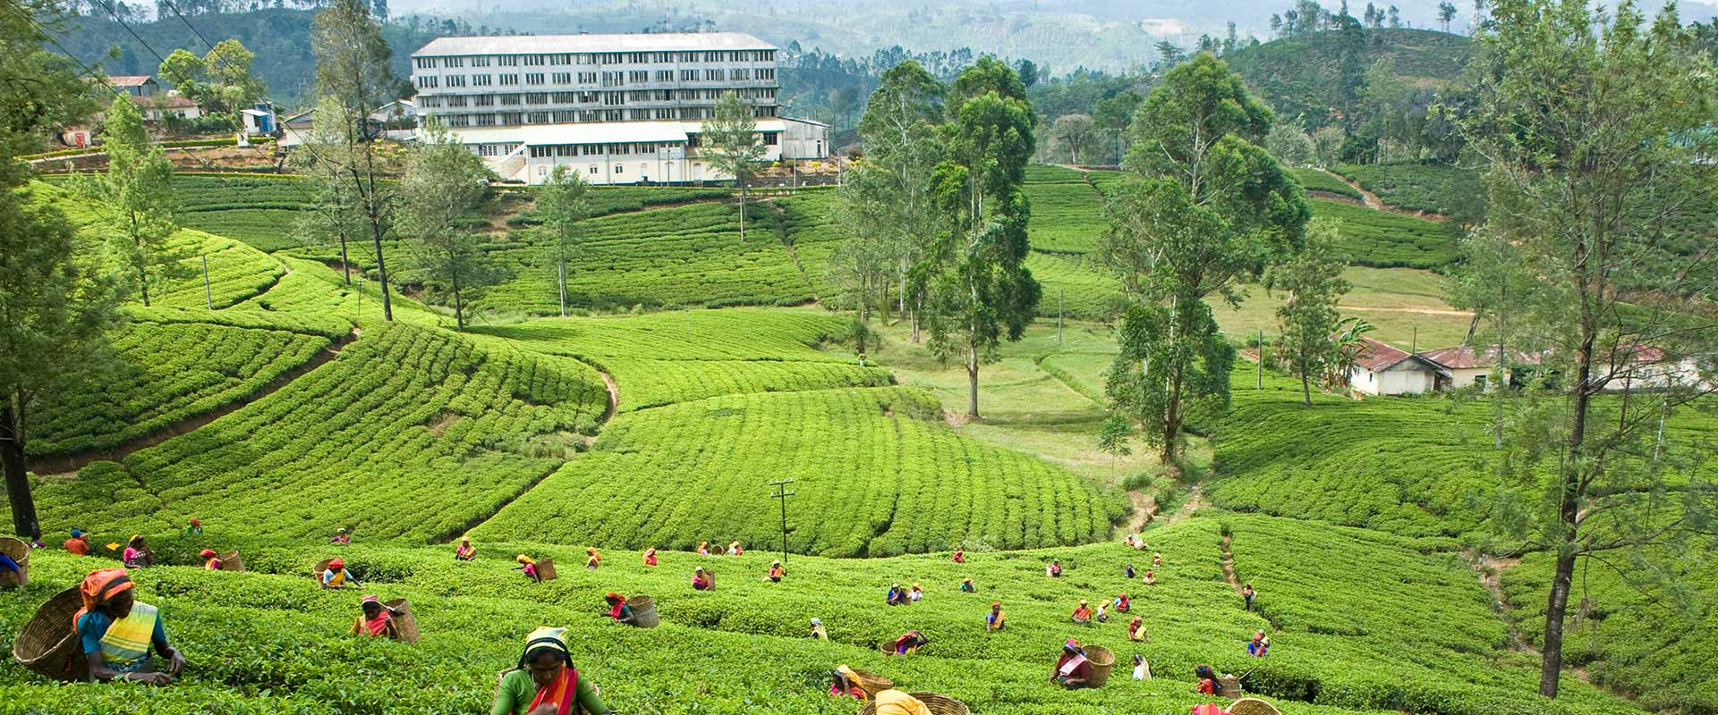
Importance of Ceylon tea in the global market
Quality Reputation:
Ceylon Tea has gained worldwide acclaim for its quality standard, different flavor profiles, and rich aromas.
The Lion Logo, under which the Sri Lanka Tea Board operates, makes certain that the tea with this mark originates, is grown, harvested, and packaged in Sri Lanka to guarantee authenticity and quality.
Diverse Flavor Profiles:
The varied geography of Sri Lanka encompasses diverse flavor profiles of tea, which can appeal to quite a wide range of tastes.
Nuwara Eliya is a high grown tea in light and delicate flavour.
The mid-grown teas of Kandy are full-bodied and strong.
Low-grown tea, which is grown in Ruhuna, has a darker colour and is rich and robust in taste.
Its diversity permits Ceylon Tea to fulfill the changing preferences and views of different consuming world markets.
Key Exporter in the Global Market:
Sri Lanka is among the world's leading five exporters of tea and exports to more than 160 countries around the world.
Major markets for Ceylon Tea include Russia, Turkey, Iraq, Iran, and the Middle East, for which it enjoys high demand.

Slide 5

Contribution of Ceylon tea to economy
Exports: The main export commodities for Sri Lanka include tea, accounting for about 10% of the total export earnings.
Employment: The industry employs over a million people: tea pluckers, factory workers, and management.
Foreign Exchange: The large foreign exchange earned through the tea industry that may balance the trade deficits.

Slide 6

Tea and tourism
Tea Plantations Tours:
Most of the tea estates in Sri Lanka are popular among tourists due to their scenic nature; some are located around Nuwara Eliya, Ella, and Kandy.
They have tea plantations, get information on how the tea is grown, and see hand-plucked tea.
Tea Trails and Eco-Tourism:
Tea trails and packages for eco-friendly tourism are popular amongst tourists who like their travel in environment-friendly style.
While most of these tea estates offer luxury accommodation in refurbished plantation bungalows, it affords the tourists an immersive experience.
Tea Festivals and Events:
Sri Lanka boasts some of the best tea festivals and events in the world, where many people attend from all walks of life.
Events will take place to discover the process of tea-making, attend tea ceremonies, and celebrate the important beverage within Sri Lankan culture.

Slide 7
Challenges in the tea industry
Labor Shortages:
Workforce aging due to migration of the younger generation to towns and cities for better opportunities.
This also resulted in a decreased ability to attract new labor to the plantations, which meant lesser productivity.
Price Volatility:
Global tea prices fluctuate depending on supply and demand dynamics, which again impinge on profitability.
Price competition from other tea-producing countries influences its market share, therefore.
Climate Change:
These changes include unstable rainfall, droughts, and temperature fluctuations that might last for periods.
Adverse conditions impact growth, yield, and quality in tea and hence affect its sustainability.
Pests and Diseases:
Poor resistance to pests like tea mosquito and diseases that generally attack tea plants.
Along with effective control strategy, there is a greater call for reliance on pesticides.

Slide 8
Government policies and support
Government Policies:
Regulatory Framework: Provides the appropriate setup of rules and regulations for industries that ensure fair competition, consumer protection, and sustainability.
Tax Incentives: These include providing tax breaks or credits to businesses to encourage investment, innovation, and job creation.
Public Spending: It involves infrastructure projects, healthcare, education, and social services, which are all funded in an effort to spur economic activity.
Government Support:
Financial Assistance: It encompasses the different forms of grants, loans, and subsidies to help in either starting or aiding ailing sectors or small businesses.
Training Programs: workforce development initiatives which improve skills and employability.
Research and Development Funding: It provides for novelty through grants and in collaboration with research institutions.

Slide 9
Future of Ceylon tea
Market Trends and Opportunities Growing Global Demand: High-end, organic, and ethically produced interest in teas is on the rise, especially in the development markets of Europe, the U.S., and Asia.
Product diversification: The scope of diversification from traditional black tea into green tea, herbal blends, and ready-to-drink tea products. Digital Transformation Adoption of e-commerce and digital marketing to eliminate intermediaries and reach global consumers directly.
Organic Farming: More interest in organic farming, less pesticide use, and better water conservation methods.
Impact of Climate Change: Temperature rise, including climate variability, puts extreme stress on tea plants and crops.

Slide 10
Conclusion
Future Outlook: A short projection into the future, concerning trends and development on the topic, is made.
Call to Action: A call to action is made, including specific actions which the audience would take in further research, engagement, or strategies put into action from the presentation.
Impact and Importance: Re-emphasize the importance of the subject matter and how it impacts the industry, organization, or community.
Final Thought or Quote: Conclude with something memorable, either in a closing statement or with a quote that causes the audience to remember the thought.

Slide 11
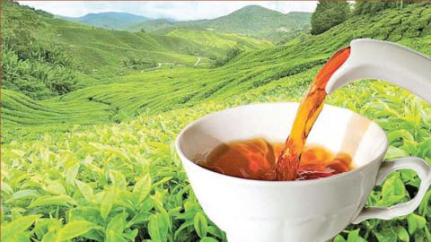
The end

